Slide 1
Fine-tuning Llama2-7B-Chat for Privacy Policy Q&A and Summarization
(Fine-tuning Llama2)
Chris Puzzo, Christian Jackson
5/14/2024
UNH COMP 741/841 Sabin

Slide 2
Overview of AI System
(Christian)
Problem: Can a smaller, locally hosted, LLM be fine-tuned to exhibit expertise in a particular domain e.g. structure and content of privacy policies?
Benefits
lower costs
privacy
Proposed Solution
7 billion parameter LLM that can be used to summarize and answer questions about privacy policies.
Natural language processing (NLP)
Text summarization
Question / answer
Large Language Model – Meta Llama 2-7b (Meta AI 2023)
Dataset: sjsq PrivacyPolicy

Slide 3
Preview of Findings
(Christian)
What we accomplished:
Fine-tuned a Llama2-7b LLM using QLoRA and PEFT techniques with a privacy policy dataset
Evaluated and compared a fine-tuned LLM to its un-tuned model
Calculated ROUGE scores for test results
Got local Llama-7B and 13B LLM models running locally on an M3 MacBook Pro / 24GB (Note: we didn’t use these instances for our testing)
Findings
No significant improvements over the baseline Llama2 model
ROUGE scores show minimal improvement in a couple of test questions and regression in others
Untuned Llama 2 model performed well, but also exhibited issues

Slide 4
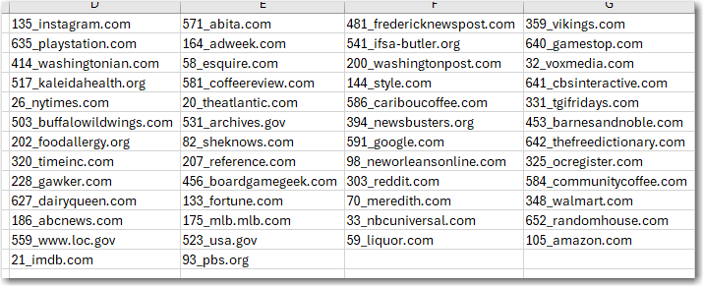
Training Dataset
(Christian)
Source: https://huggingface.co/datasets/sjsq/PrivacyPolicy
CSV contains 1789 records
50 unique privacy policies

Slide 5
Overview of Theoretical Background
(ChrisP)
Theoretical background
LLMs, Transformers
NLP Tasks
Fine Tuning
PEFT / QLoRA (Mangrulkar et. al 2022)

Slide 6
AI System: structure, functionality, and performance (ChrisP)
Built using several Huggingface resources
Transformers
Llama 2 (7b-chat model)
PEFT/QLoRA
Functionality
Ask questions about privacy policies
Get a summary of a privacy policy
Performance:
Hallucination,
Testing methodology: ROUGE

Slide 7
Testing Methodology
(Christian)
ID | Question Text
q1 | What types of personal data collection are allowed by this policy?
q2 | Does this policy address data sharing with third parties?
q3 | How does this company share user data with third parties?
q4 | How does this company collect data?
q5 | How can I opt out of data collection or marketing?
q6 | How often is this policy reviewed and updated?
q7 | How does this policy cover the use of cookies?
q8 | Does this policy describe the use of third party services?
q9 | How does this policy govern the use of my data?
q10 | Summarize this privacy policy for me.
q11 | How can I opt out of data collection or marketing communications from this policy
q12 | How can this privacy policy be improved?
Twelve prompts containing the text of the TopHive.ai privacy policy and one of 12 test questions were processed against three LLMs.
(Note: we attempted to use Starbucks’ privacy policy)
Three LLMs used:
GPT4 used to generate a reference text responses (This could also have been done by a human)
Standard Llama2-7b LLM used for untuned text responses
Fine-tuned Llama2-7b LLM used for candidate text responses

Slide 8
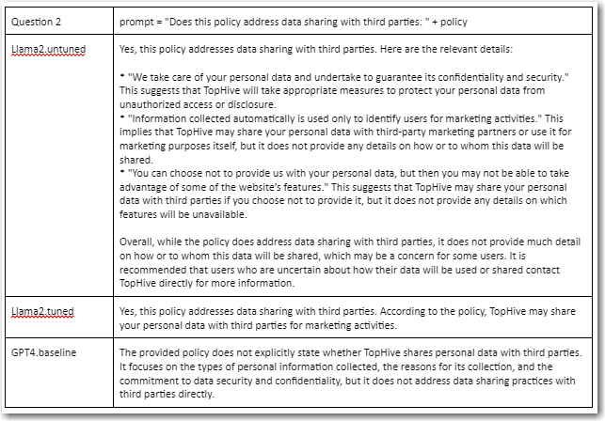
Example Question and Responses
(Christian)

Slide 9
ROUGE Score
(Christian)
ROUGE = Recall-Oriented Understudy for Gisting Evaluation
Used for evaluating text summarization tasks
Compares machine generated summaries to summaries provided by humans
Measures the similarity between the two summaries by comparing word sequences that appear in both
PROS: Easy to compute
CONS: Doesn’t handle synonyms well

Slide 10
Calculating ROUGE Scores / Metrics
(Christian)
ROUGE-1 — measures unigram overlap (number of single word matches)
ROUGE-2 — measures bigram overlap (number of two word sequence matches)
ROUGE-L — measures longest matching sequence of words
Recall – how much of a candidate text summary is included in a reference text summary
Precision — ratio of unigrams or bigrams that are common to both a candidate text summary and a reference text summary to the total unigrams or bigrams in the candidate text summary
Recall = overlapping_sequences / total_sequences_in_the_REFERENCE
Precision = overlapping_sequences / total_sequences_in_SYSTEM_SUMMARY
F1-score = 2 * (precision * recall) / (precision + recall)

Slide 11
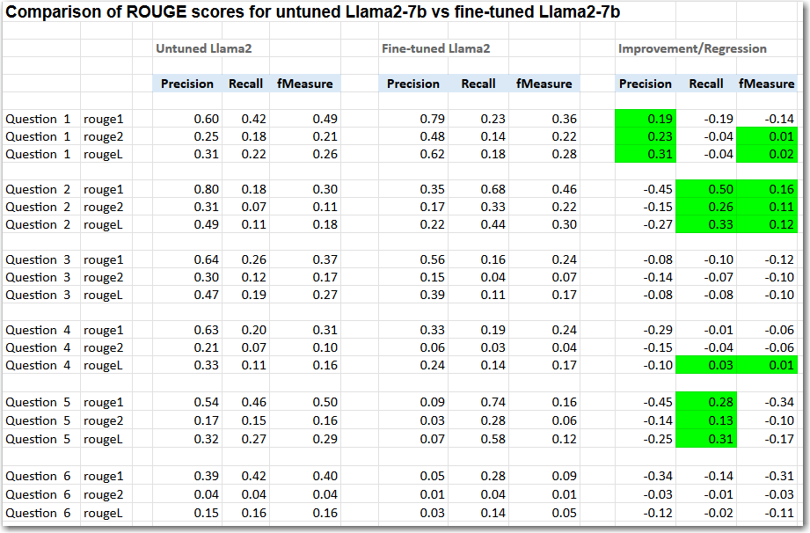

Slide 12
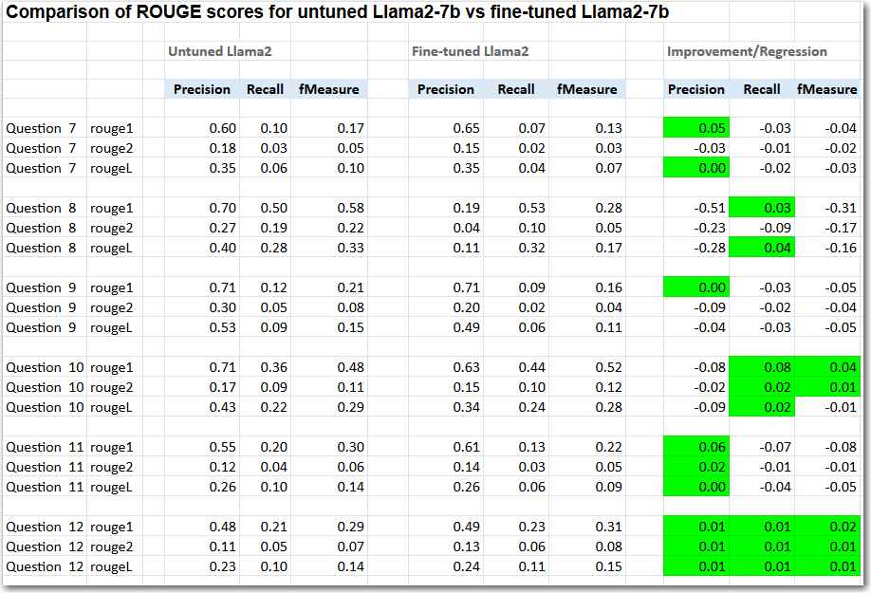

Slide 13
Test Results
(Christian)
The fine-tuned Llama-2-7b LLM did not perform as well as we’d hoped. Some possible reasons for the poor performance could be:
Dataset used for fine-tuning was not adequate in size
Dataset used for fine-tuning was not adequate in quality of content or structure
The benchmark responses from ChatGPT4 could be improved by humans
Improved test prompts may make a difference
7B parameter model may be too small for this task.
ROUGE metric may not adequately measure the quality of responses.

Slide 14
Demo: Fine-tuning
(Chris)

Slide 15
Project Management
(Christian)
Week 1 Milestones:
Research into models + techniques
Finished proposal
Week 2 Milestones:
Research into datasets
Research into PEFT and QLoRA
Finished Design
Week 3 Milestones:
Researched ROUGE testing metric
Parsing, loading tuning dataset
Deployed Llama 2 in a test environment
Deployed Llama 2 on a MacOS environment
Researched fine-tuning Llama 2 on Colab
Found an open-source notebook to use to fine-tune
Week 4 Milestones:
Iterated on code development/test cycles
Trained the PEFT adapter
Started fine-tuning with the dataset
Put the model on Hugging Face
First project presentation
Week 5 Milestones:
Finished code adaptation/debugging
Test case development
Test case execution
Evaluate the model qualitatively (human)
Calculated test results (ROUGE scores)
Report writing
Week 6 Milestones (projected):
Re-calculated test results
Final oral presentation

Slide 16
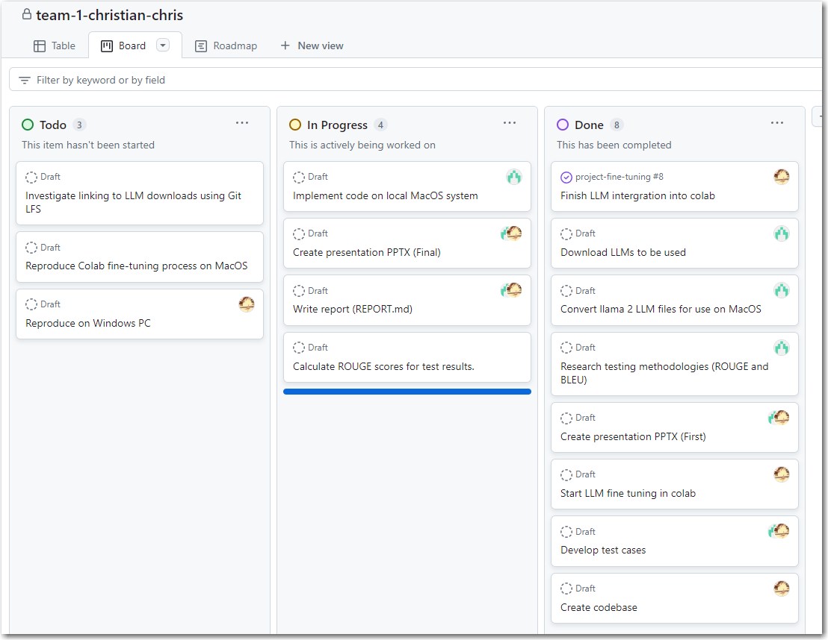
Project Management
(Christian)

Slide 17
References
Meta AI. 2023. “Llama 2: Open Foundation and Fine-Tuned Chat Models”. Accessed April 29 2024. https://scontent-bos5-1.xx.fbcdn.net/v/t39.2365-6/10000000_662098952474184_2584067087619170692_n.pdf?_nc_cat=105&ccb=1-7&_nc_sid=3c67a6&_nc_ohc=slMdknTWhmgAb4No-kc&_nc_ht=scontent-bos5-1.xx&oh=00_AfDsuxJIzD0TuuI-UnHAnMN99UoPSUpXJ3oe8jCo9NRdgg&oe=6635EA3F
Sourab Mangrulkar and Sylvain Gugger and Lysandre Debut and Younes Belkada and Sayak Paul and Benjamin Bossan. 2022. “PEFT: State-of-the-art Parameter-Efficient Fine-Tuning methods”. Accessed April 29 2024. https://github.com/huggingface/peft
Sjqj. 2024. “PrivacyPolicy”. Accessed April 29 2024. https://huggingface.co/datasets/sjsq/PrivacyPolicy
Belkada, Younes, Jul 21, 2023, finetune_llama_v2.py. Accessed April 29, 2024. https://gist.github.com/younesbelkada/9f7f75c94bdc1981c8ca5cc937d4a4da
Chiusano, Fabio. 2023. “Two Minutes NLP — Learn the ROUGE Metric by Examples.” NLPlanet (blog). August 4, 2023. Accessed April 30, 2024. https://medium.com/nlplanet/two-minutes-nlp-learn-the-rouge-metric-by-examples-f179cc285499.

Slide 18
References
Nousresearch. 2023. “Llama-2-7b-chat-hf”. Accessed 2024. https://huggingface.co/NousResearch/Llama-2-7b-chat-hf
Meta AI. 2023. “Llama 2: Open Foundation and Fine-Tuned Chat Models”. Accessed 2024. https://scontent-bos5-1.xx.fbcdn.net/v/t39.2365-6/10000000_662098952474184_2584067087619170692_n.pdf?_nc_cat=105&ccb=1-7&_nc_sid=3c67a6&_nc_ohc=slMdknTWhmgAb4No-kc&_nc_ht=scontent-bos5-1.xx&oh=00_AfDsuxJIzD0TuuI-UnHAnMN99UoPSUpXJ3oe8jCo9NRdgg&oe=6635EA3F
Wolf, Thomas, Lysandre Debut, Victor Sanh, Julien Chaumond, Clement Delangue, Anthony Moi, Pierric Cistac, et al. 2020. “Transformers: State-of-the-Art Natural Language Processing.” In Proceedings of the 2020 Conference on Empirical Methods in Natural Language Processing: System Demonstrations, 38–45. Online: Association for Computational Linguistics. https://doi.org/10.18653/v1/2020.emnlp-demos.6.
Labonne, Maxime. 2023. “Fine-tune Llama 2 in Google Colab”. Accessed 2024. https://colab.research.google.com/drive/1PEQyJO1-f6j0S_XJ8DV50NkpzasXkrzd
Sjsq. 2024. “PrivacyPolicy”. Accessed 2024. https://huggingface.co/datasets/sjsq/PrivacyPolicy
Mangrulkar, Sourab, Gugger, Sylvain, Debut, Lysandre, Belkada, Younes, Paul, Sayak, Bossan, Benjamin. 2022. “PEFT: State-of-the-art Parameter-Efficient Fine-Tuning methods”. Accessed 2024. https://github.com/huggingface/peft
Google_opensource, 2022. rouge-score 0.1.2 library (https://pypi.org/project/rouge-score/)
Vaswani, Ashish, Noam Shazeer, Niki Parmar, Jakob Uszkoreit, Llion Jones, Aidan N. Gomez, Lukasz Kaiser, and Illia Polosukhin. 2017. “Attention Is All You Need.” https://doi.org/10.48550/ARXIV.1706.03762.

